Slide 1
Prediction Algorithm for Weekly Asthma Admissions
Presented By:
Stephen Colegate, Ph.D.
Postdoctoral Research Fellow
stephen.Colegate@cchmc.org

Slide 2
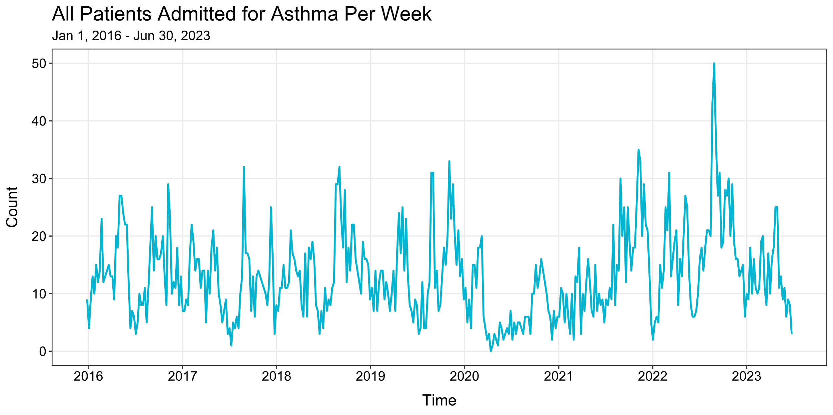

Slide 3
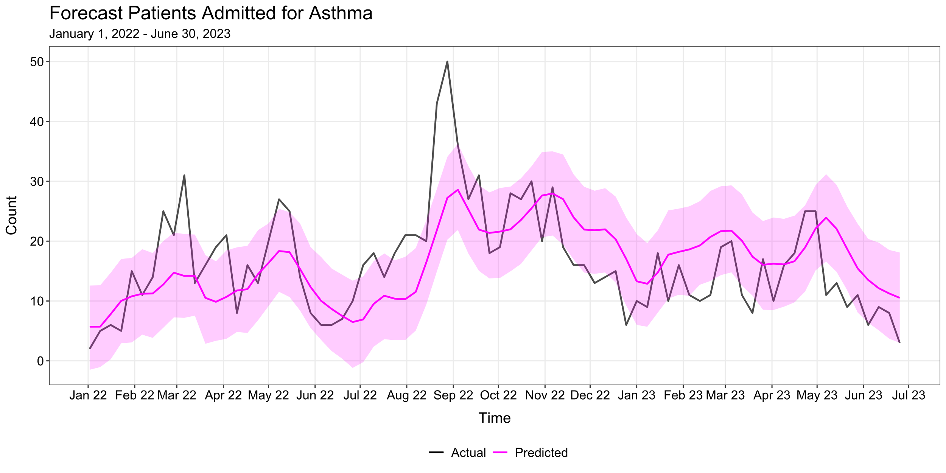

Slide 4
Thoughts & Discussion

